Slide 1
Directions to Download and Install: 1. SQL Server 2014 Evaluation Edition 2. SQL Server Data Tools

Slide 2
Download SQL Server 2014 Evaluation (free)
Visit the following site:
http://www.microsoft.com/en-us/evalcenter/evaluate-sql-server-2014
You need to sign in to download SQL Server 2014 SP1. If you have not registered before, you will be asked to do so.
Be sure to download either 32-bit or 64-bit version, matching your 32-bit or 64-bit computer system.
You might want to download the software as a BOX, ISO, or CAB file. If BOX format, you will download two files:
SQLServer2014SP1-FullSlipstream-x64-ENU.exe (for 64-bit version)
SQLServer2014SP1-FullSlipstream-x64-ENU.box (for 64-bit version)

Slide 3
Download SQL Server Data Tools (free)
Visit the following site:
http://www.microsoft.com/en-us/download/details.aspx?id=42313
Be sure to download either 32-bit or 64-bit version, matching your 32-bit or 64-bit computer system.
In my case, the filename is SSDTBI_x86_ENU.exe

Slide 4
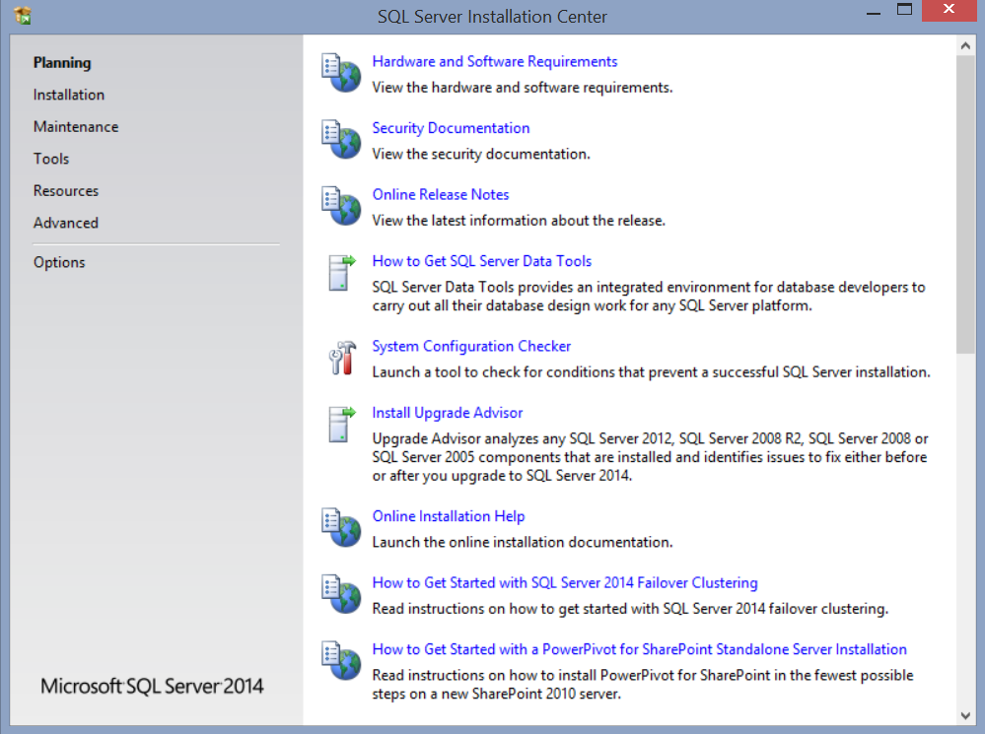
Install SQL Server 2014 Evaluation
Run the downloaded file (in my case, it is SQLServer2014SP1-FullSlipstream-x64-ENU.exe) to create a new folder and extract the accompanying BOX file. It should then automatically run setup. If not, then navigate to the newly created folder and run Setup.exe.
You should see the SQL Server Installation Center window (see below):

Slide 5
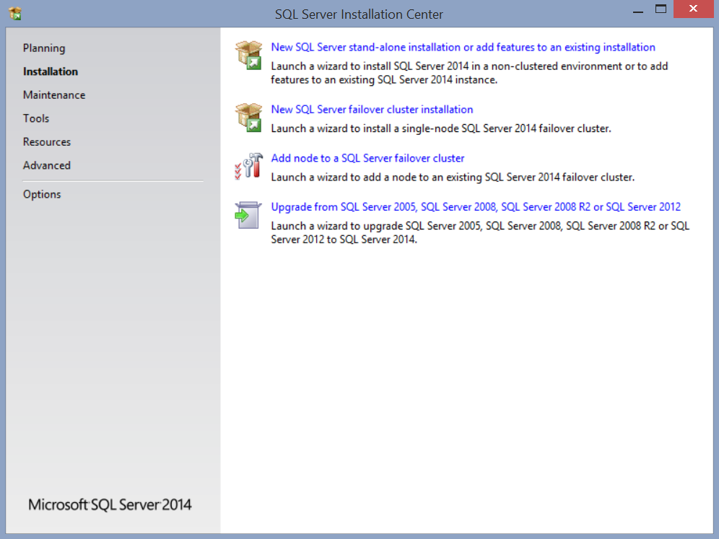
Install SQL Server 2014 Evaluation (continued)
1. Select Installation
2. Click this link. Wait and follow the directions on the screen until you see the following screen (see next slide)

Slide 6
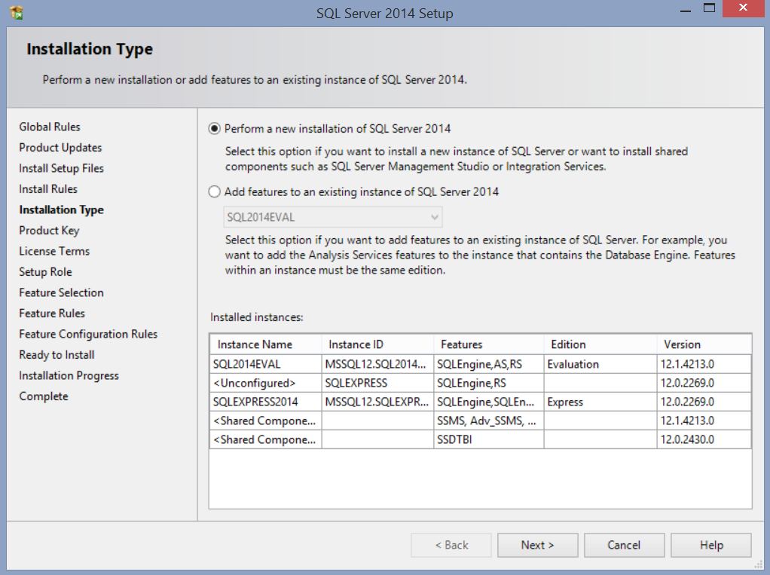
Install SQL Server 2014 Evaluation (continued)
1. Select this option
2. For the first installation, this area would most likely be empty.
3. Click Next

Slide 7
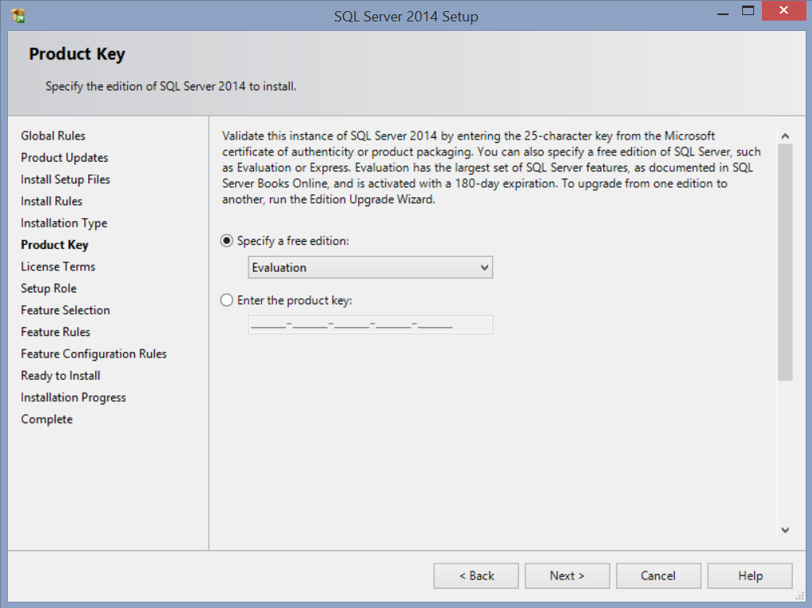
Install SQL Server 2014 Evaluation (continued)
1. Select Evaluation
2. Click Next

Slide 8
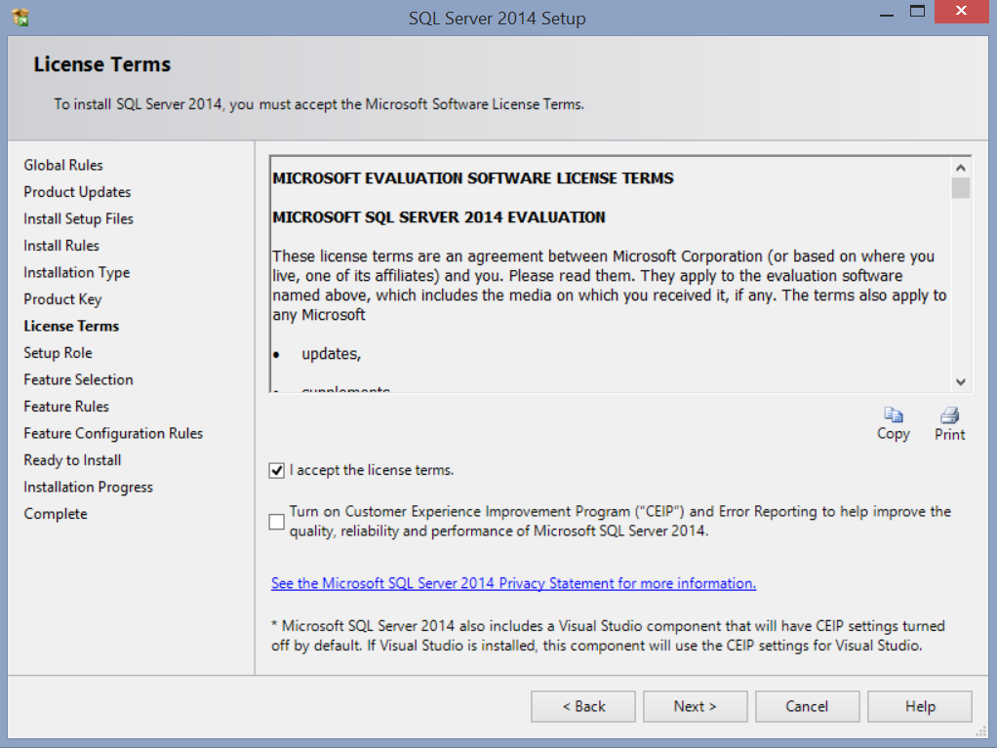
Install SQL Server 2014 Evaluation (continued)
1. Check this option
2. Click Next

Slide 9
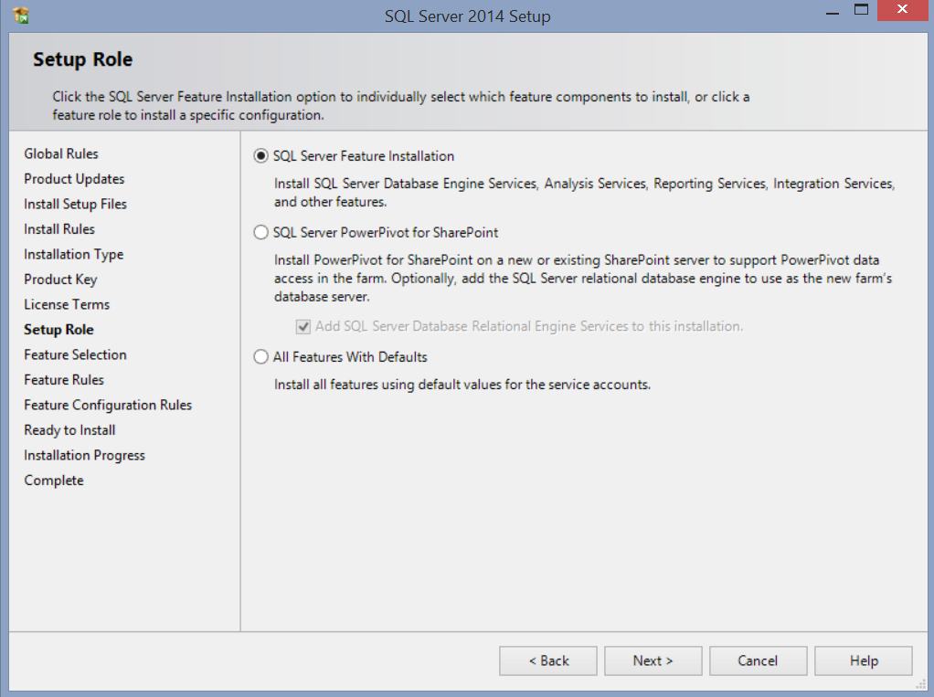
Install SQL Server 2014 Evaluation (continued)
1. Select this option
2. Click Next

Slide 10
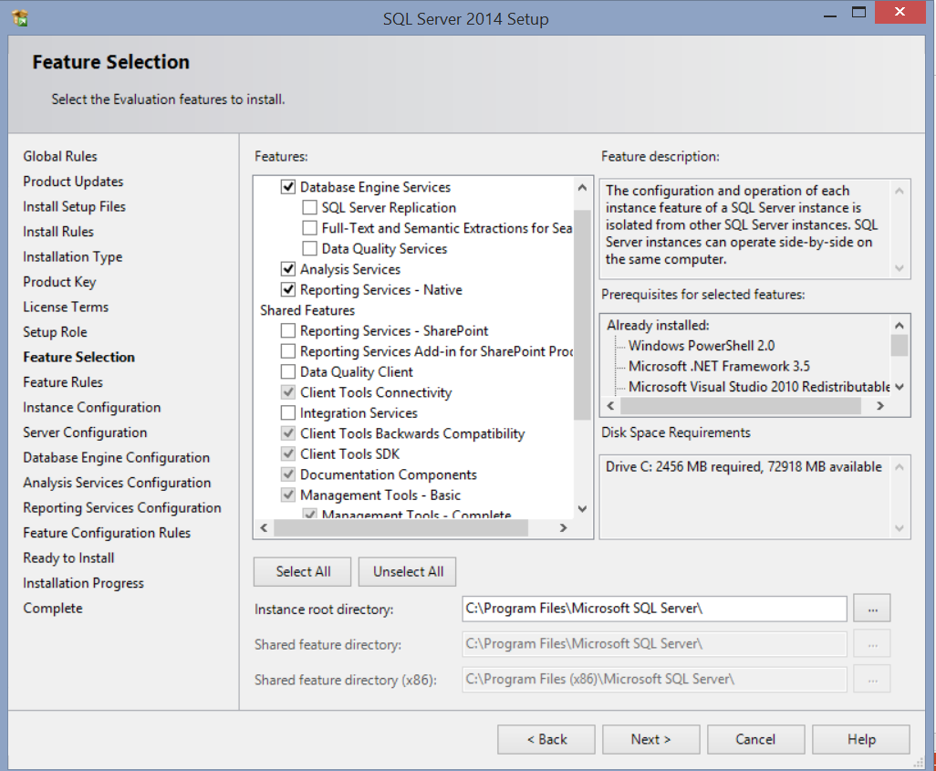
Install SQL Server 2014 Evaluation (continued)
1. Check Database Engine Services, Analysis Services, and Reporting Services
2. Be sure that Management Tools Basic and Complete are checked
3. Click Next

Slide 11
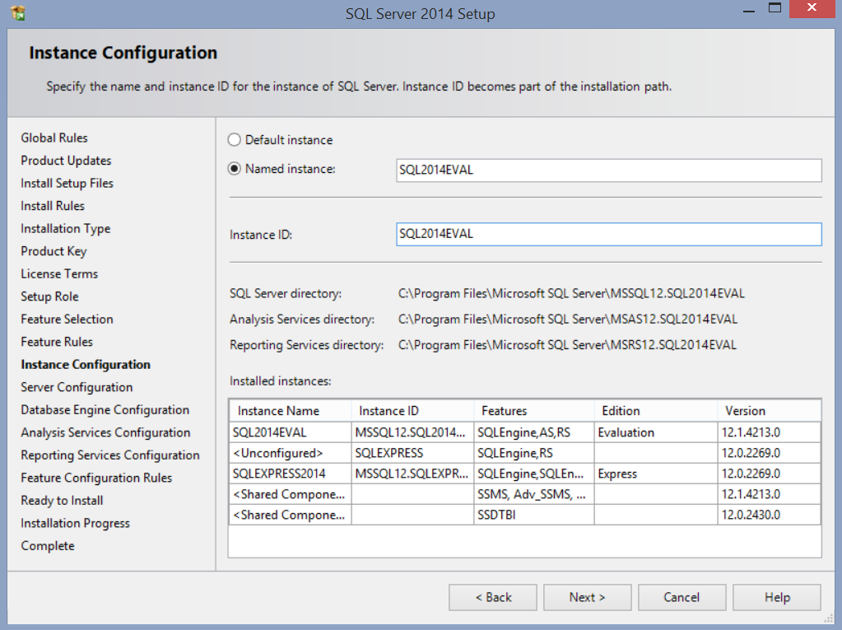
Install SQL Server 2014 Evaluation (continued)
1. Specify the database named instance. You need to remember this name when you want to login to the SQL Server
2. In this area, you might see different names from what you see here.
3. Click Next

Slide 12
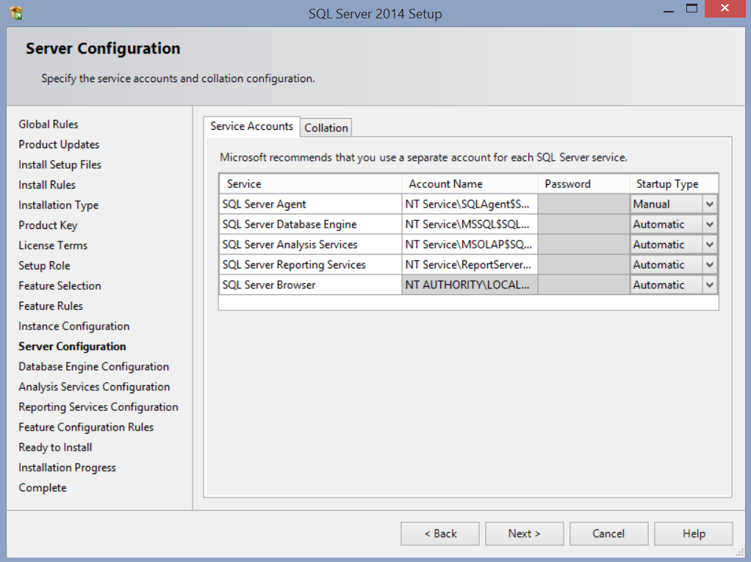
Install SQL Server 2014 Evaluation (continued)
1. Nothing to change on this screen. Click Next

Slide 13
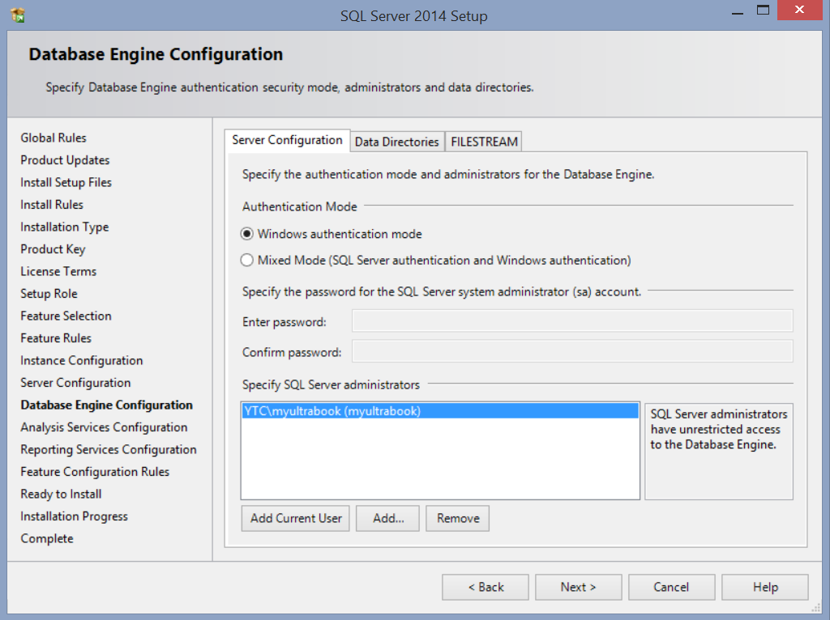
Install SQL Server 2014 Evaluation (continued)
1. Select Windows authentication mode
2. Click Add Current User button
3. At this point, you should see the current user name (administrator) in this area.
4. Click Next

Slide 14
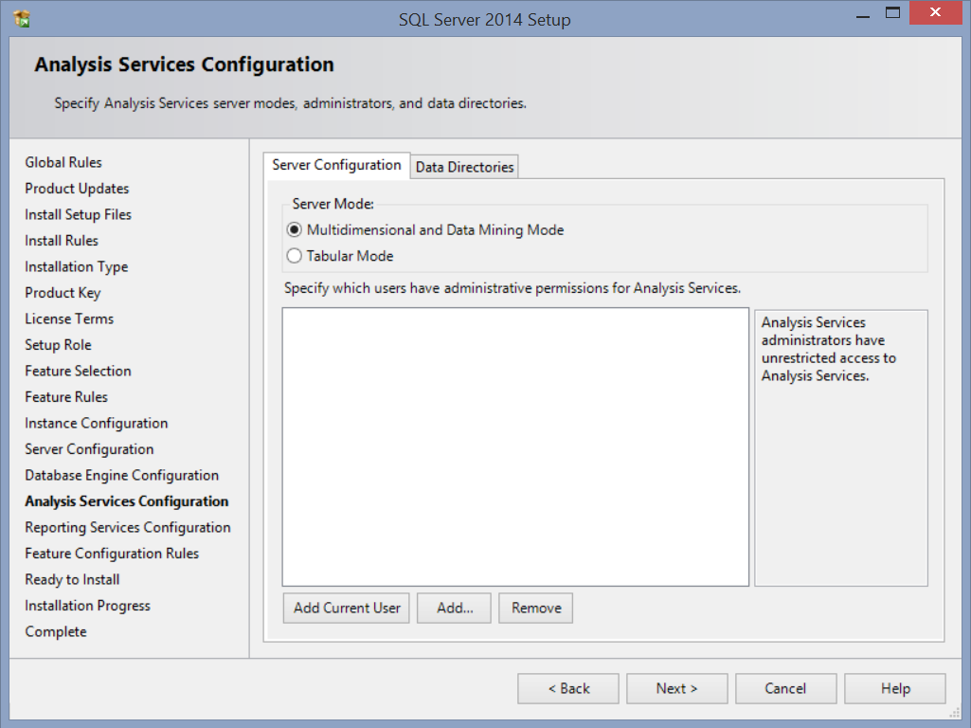
Install SQL Server 2014 Evaluation (continued)
1. Select Multidimensional and Data Mining Mode
2. Click Add Current User button
3. At this point, you should see the current user name (administrator) in this area.
4. Click Next

Slide 15
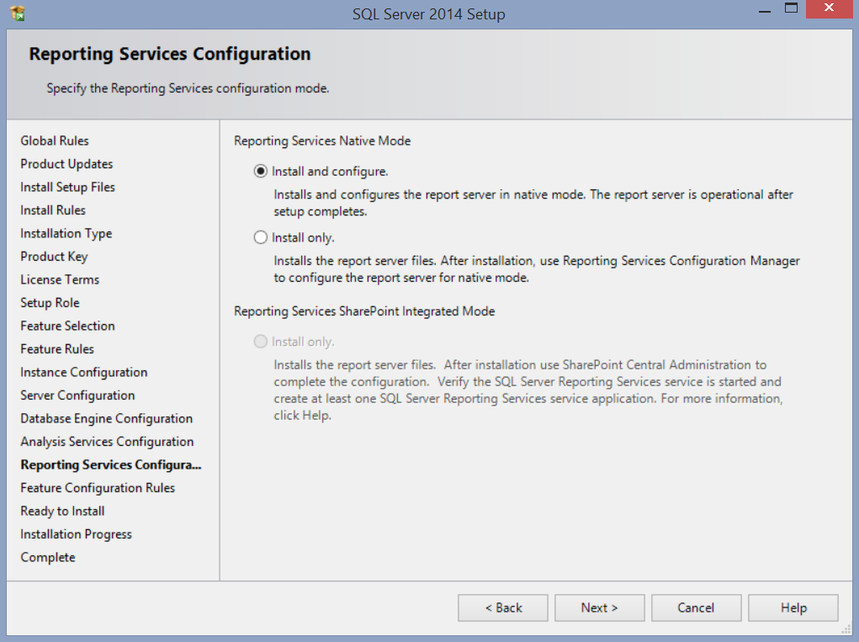
Install SQL Server 2014 Evaluation (continued)
1. Select this option
2. Click Next

Slide 16
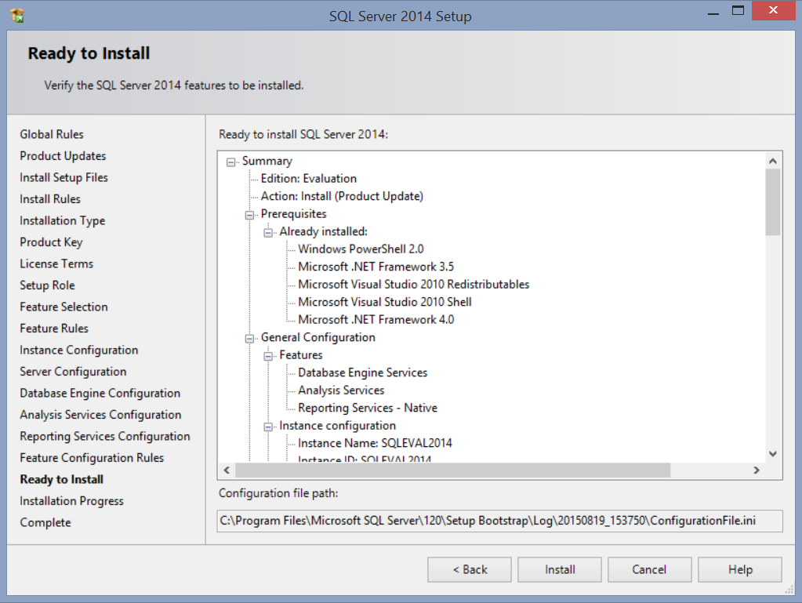
Install SQL Server 2014 Evaluation (continued)
1. Click the Install button. Wait until SQL Server 2014 installation is completed.

Slide 17
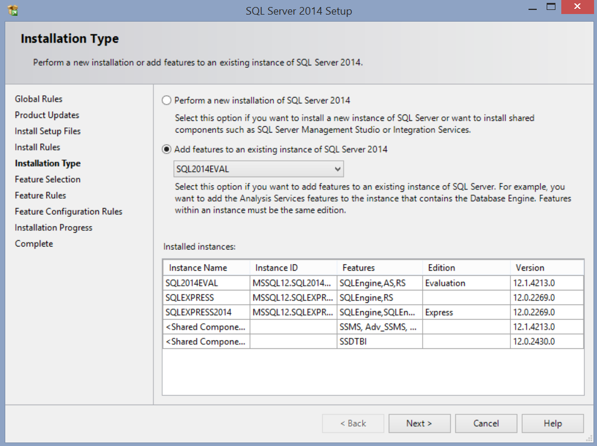
Install SQL Server Data Tools
Run the downloaded file (in my case, it is SSDTBI_x86_ENU.exe) to create a new folder and extract the compressed file. It should then automatically run setup. If not, then navigate to the newly created folder and run Setup.exe.
You should see the SQL Server 2014 Setup window (see below):
1. Select Add features to an existing instance of SQL Server 2014. Note: the instance name should be the one that you specified early during the installation of SQL 2014 (see Slide #11)
2. Click Next

Slide 18
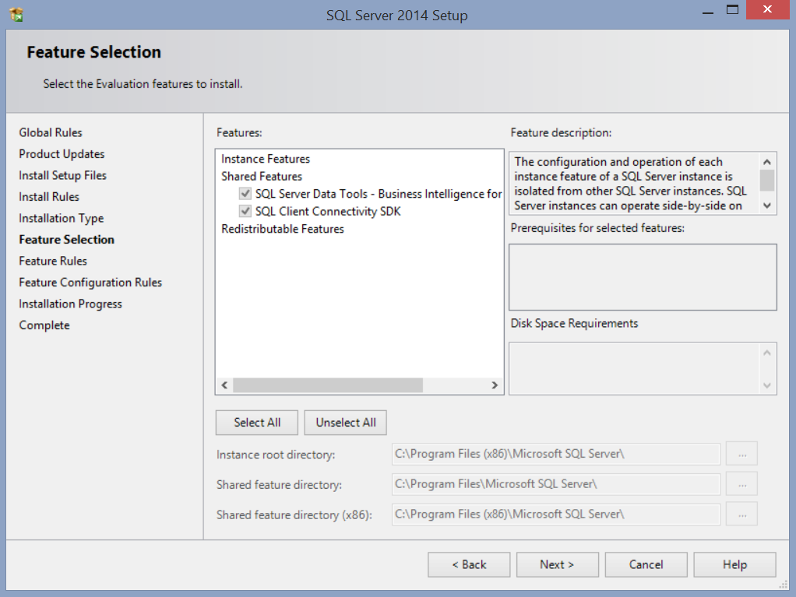
Install SQL Server Data Tools (continued)
1. Be sure to mark these two check boxes
2. Click Next
3. Follow the directions on the screen until the installation of SQL Server Data Tools is completed.

